Slide 1

Eshara
Enhancing communication by recognizing Arabic sign language in real time using artificial intelligence
تعزيز التواصل من خلال التعرف على لغة الإشارة العربية بالوقت الفعلي باستخدام الذكاء الاصطناعي
Team NovaIT :
Nemer Adel
Hammam Malabeh
Osama Nakhleh
Nour Alfarraj

Slide 2
Statistics on hearing loss and speech and problems
275,300
0.14%
430M
7.2%
Jordan Population
Newborn Cases
Global Impact
Children Affected
Citizens aged 5+ with hearing impairments (2015 Census)
Congenital hearing loss rate in Jordan (Ministry of Health 2021-2023)
People worldwide living with hearing loss (WHO 2021)
Speech and language disorders among children (2023 statistics)
Communication barriers limit educational opportunities, employment prospects, and social integration for deaf communities across Jordan and the region.

Slide 3
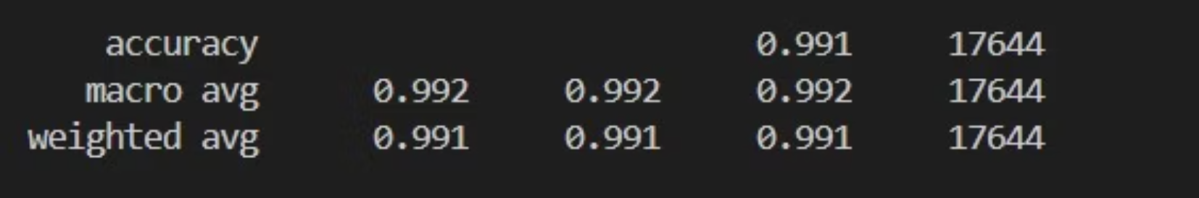

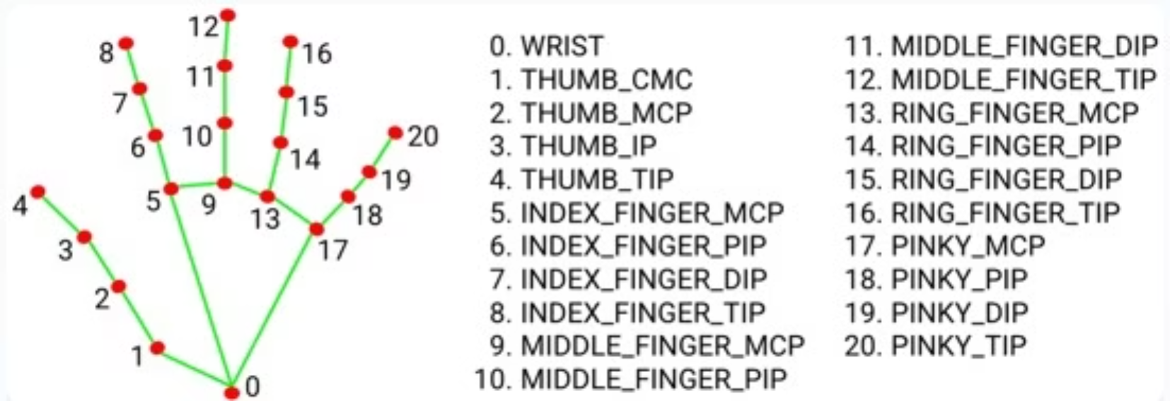


Our Solution: Eshara
Capture
Camera detects sign language gestures in real-time and convert it into text and speech.
Process
AI analyzes Arabic sign language and recognize the patterns instantly.
Translate
Converts gestures into written text and natural speech output.
Simple, intuitive interface designed with privacy-first approach and seamless user experience for all ages.

Slide 4


Innovation & Technology
MediaPipe + AI
Hand Landmark Detection
Extract Keypoints from images for sign language recognition
Google Cloud : Text To Speach
Convert text output to spoken audio
Provide audible feedbacke in the app
Firebase
Authentication and Firestore Database
Login, New Account, Forgot Password, Contact Pages

Slide 5
Demo: Touring the site

Slide 6

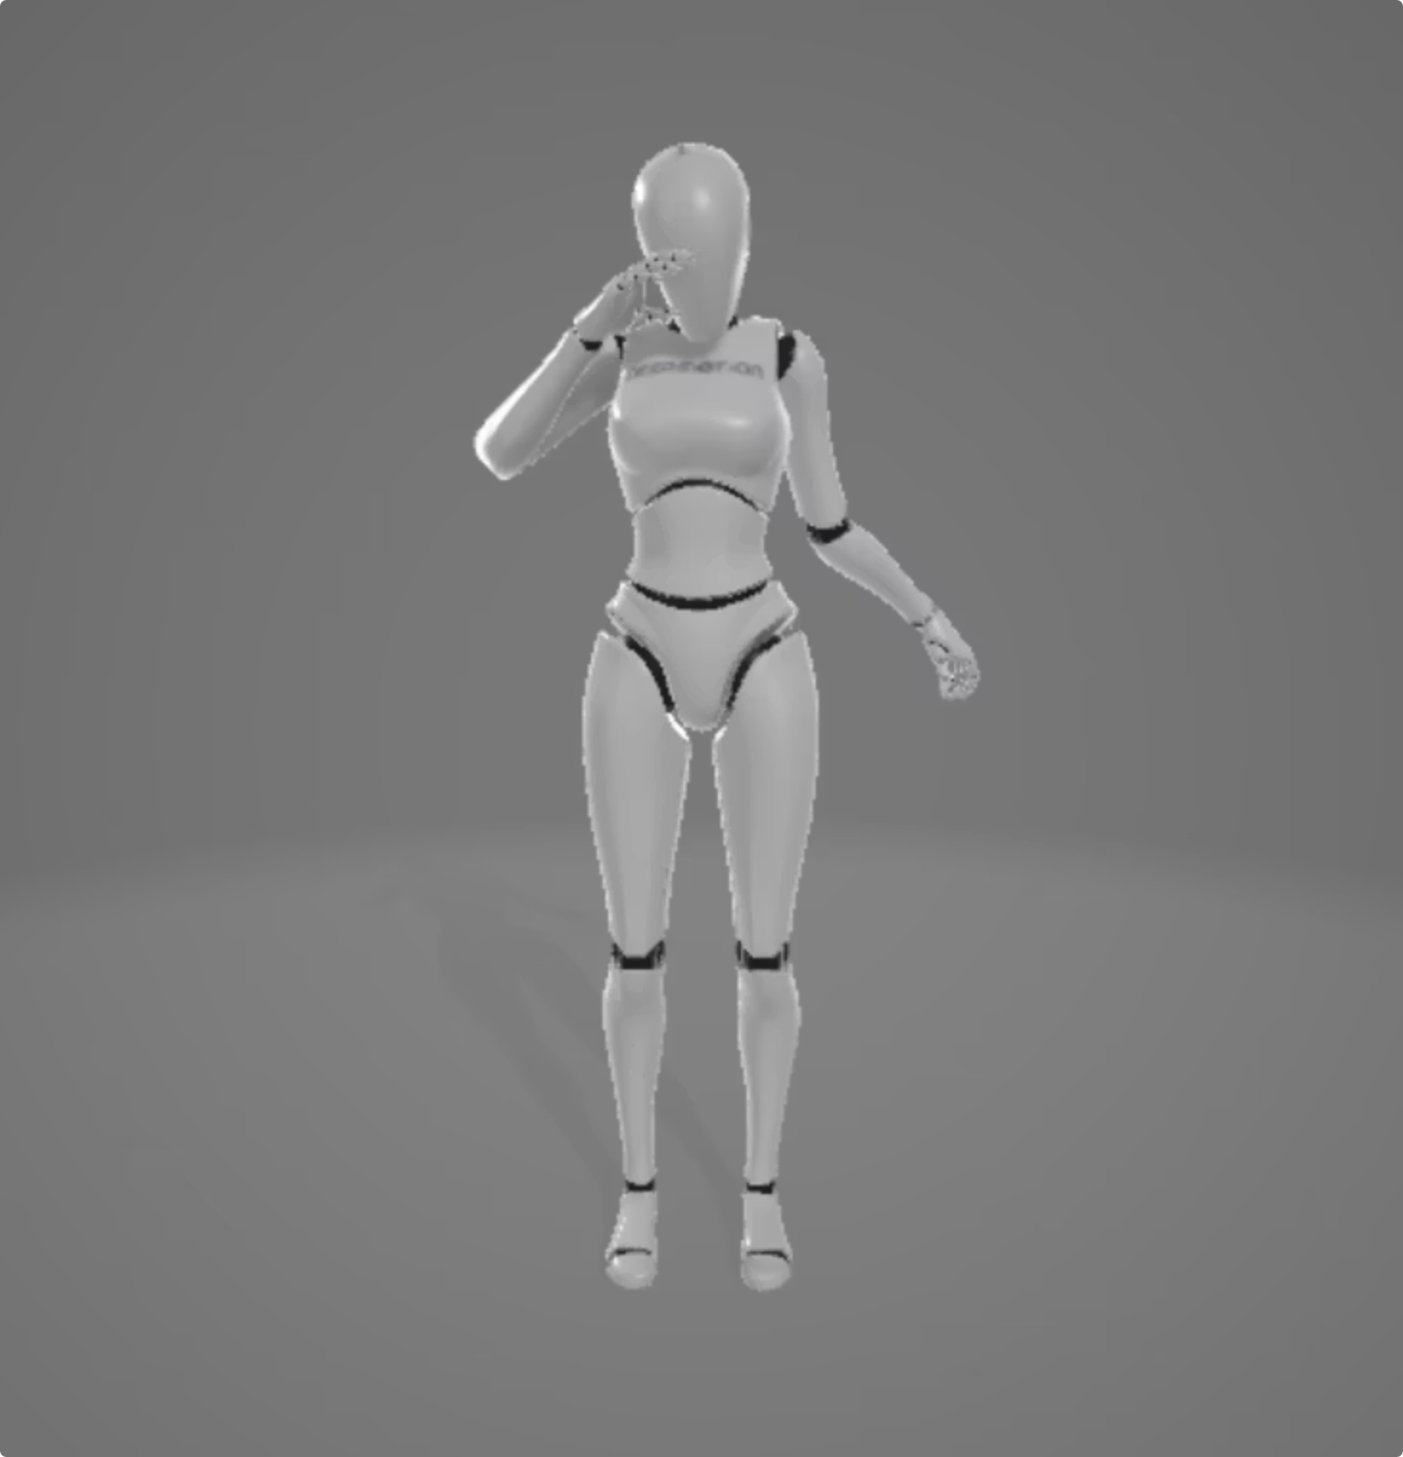



Social Impact & Growth Potential
Communication Access
Enable people with hearing impairments to communicate easily.
Improve education and work oppourtunities.
Facilitate participation in meeting and healthcare settings
System Expansion
Add more words and ready-made phrases to the database.
Develop a 3D avatar to replicate sign language gestures.
Global Reach
Build a world wide platform for barrier-free communication.
Support multiple sign languages and cultural contexts.

Slide 7
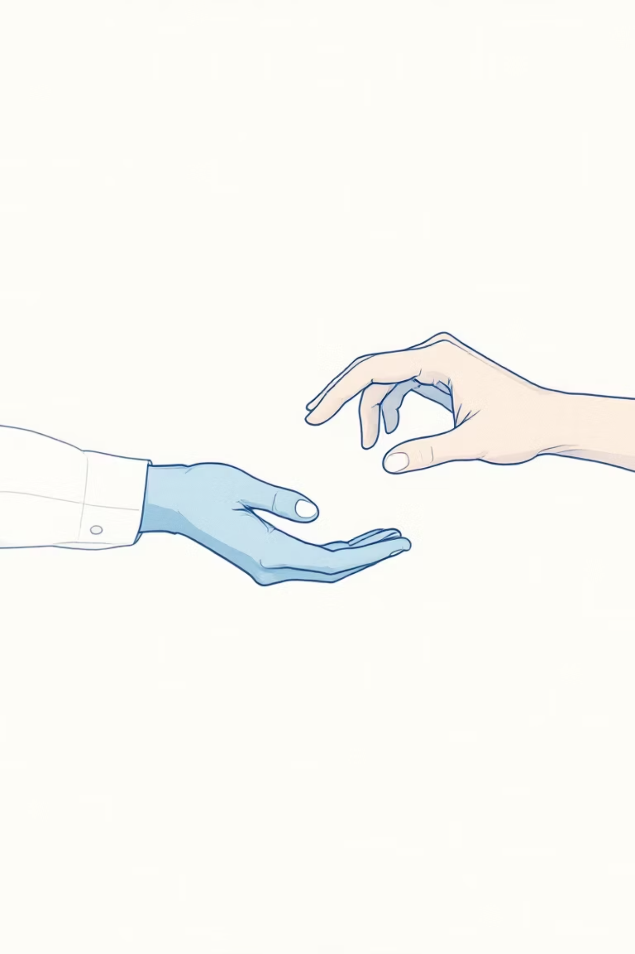

Thank You!
Transform communication accessibility in Jordan and beyond. Together, we can create a world where every voice is heard and every gesture has meaning.
Any Questions?
Links:
github Repositories: https://github.com/Imhammam/esharaa
Website: https://imhammam.github.io/esharaa/

